Slide 1
Strategic Portfolio Analysis and Investment Consultation for Clients
By:
Dhreeti Rastogi
Masthan Raja
Manaswini Pattnaik

Slide 2
AGENDA
Objective
Key findings
Portfolio Analysis
Methodology

Slide 3
OBJECTIVE
Evaluate a collection of stocks within a portfolio to offer guidance on investment management aligned with the specific needs and preferences of the client.Our task is to provide consultation to two different investors, Mr Patrick Jyenger and Mr Peter Jyenger based on their requirements and financial objectives.
Mr. Patrick Jyenger is looking to allocate $500,000 to equities. Known for his conservative investment approach throughout his life, he aims to double his capital within a 5-year period while minimizing risk.
Mr. Peter Jyenger is interested in investing $1 million in equities. Having maintained a high-risk investment strategy throughout his life, he leans towards opportunities with high returns. His objective is to double his capital within a 5-year timeframe, embracing a higher level of risk in the process.

Slide 4

KEY FINDINGS

Slide 5
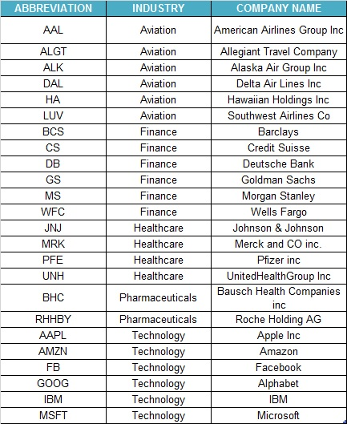
STOCK DATA
There are 24 stocks available from four sectors containing 6 stocks from each sector.
There is an index available to compare the stocks outcome with. S&P500 is a combinations of top 500 stocks in US stock market.
This is the list of stocks with their abbreviation and Industry and company name.

Slide 6
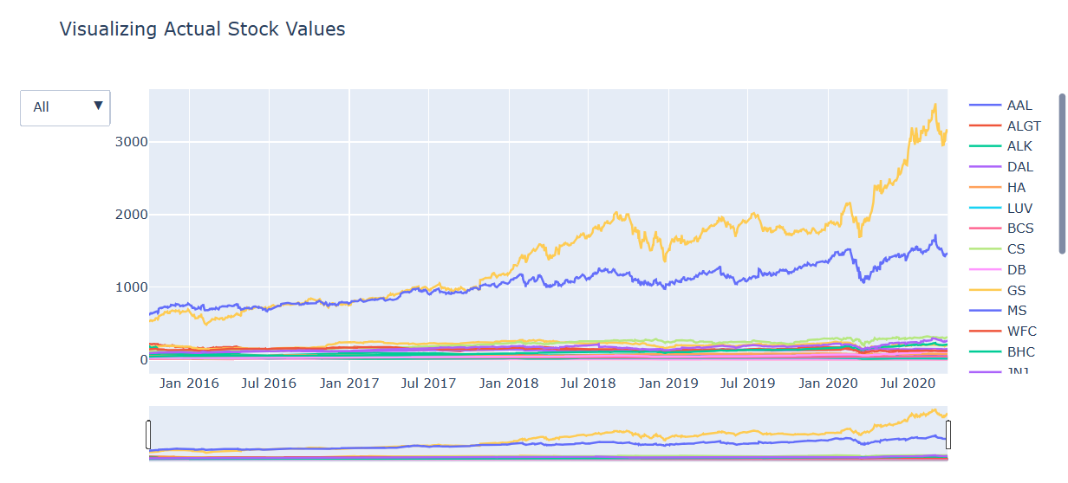
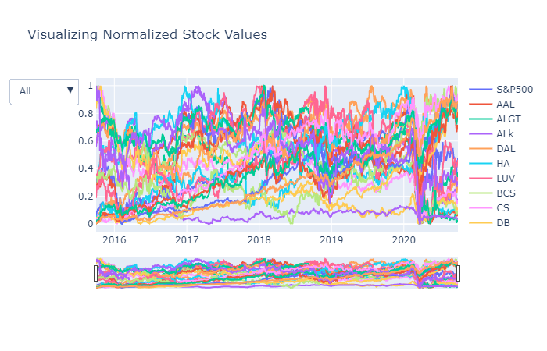
VISUALIZATION OF ACTUAL STOCK VALUES
VISUALIZATION OF NORMALIZED STOCK VALUES
The depicted graph illustrates the performance of various stocks over the past five years. It is evident from the graph that Amazon and Google have outperformed other stocks during this period.
The presented graph demonstrates the performance of all stocks relative to the S&P500 index. It is notable that eight stocks have exhibited returns exceeding 80% by the conclusion of the 5-year period

Slide 7
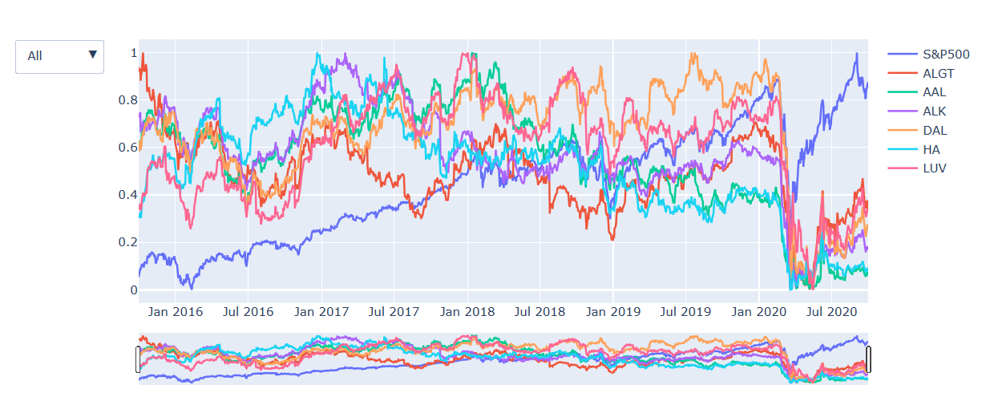
SECTOR WISE ANALYSIS-AVIATION
Market took a massive hit in 2020 due to corona pandemic which resulted in a bear market.
Even though the market recovered but the Aviation Sector underperformed the market
Despite the overall market recovery, the aviation sector struggled to regain its pre-pandemic strength. Factors such as travel restrictions, reduced passenger demand, and ongoing uncertainties in the industry may contributed to the underperformance of aviation industry contributed to the underperformance of aviation-related stocks

Slide 8
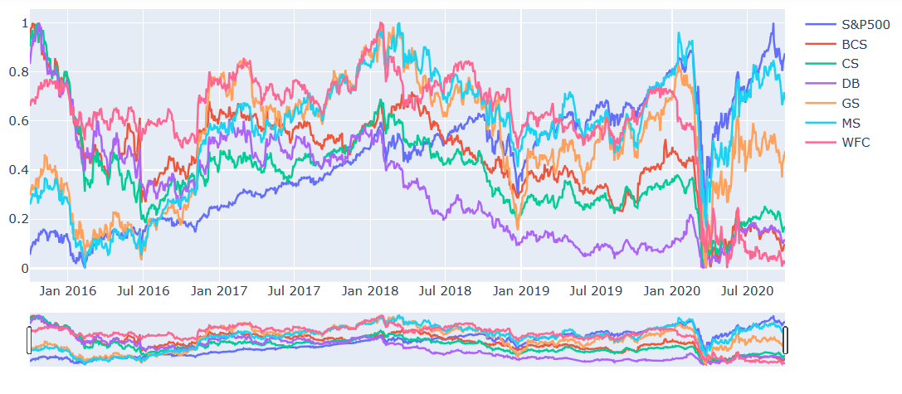
FINANCE SECTOR
Despite the significant downturn in the market in 2020 caused by the COVID-19 pandemic Morgan Stanley and Goldman Sachs not only recovered but also outperformed the sector.
While these two financial institutions managed to bounce back strongly, the majority of stocks experienced negative impacts from the pandemic-induced market challenges.

Slide 9
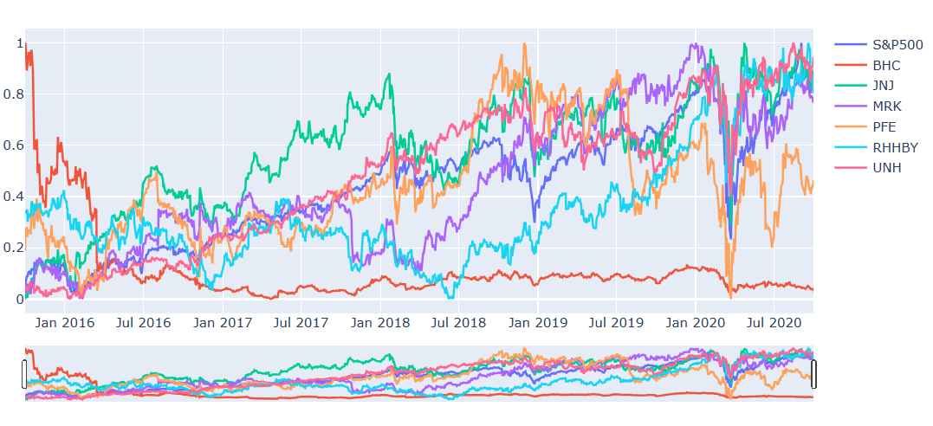
PHARMA & HEALTHCARE
Health and pharma sector showed rapid growth after the market crash due to covid pandemic in comparison to other industries.
United Health, Johnson & Johsnson have performed well when compared to S&P Index.
Bausch Health is consistently performed very badly over the years when compared to other stocks in the same sector.

Slide 10
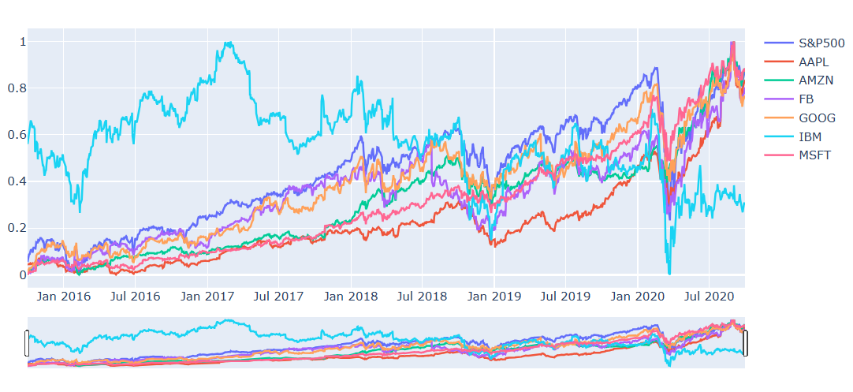
TECHNOLOGY
Microsoft, Amazon, Apple, Facebook & Google have performed well along with Market index.
The stock performed very badly over the years when compared to other stocks in the same sector is IBM.
When compared to other sectors during the pandemic Tech sector was one of few sectors to bounce back sharply.

Slide 11
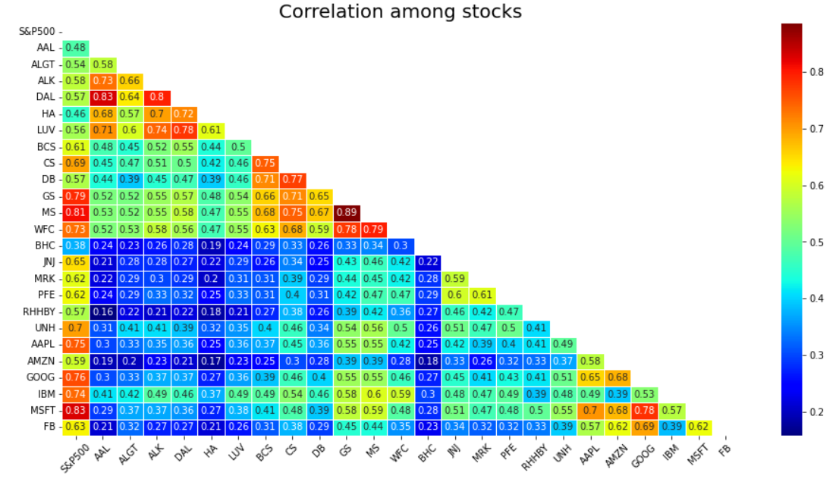
CORRELATION AMONG STOCKS
Microsoft & Google stocks are highly correlated in the Technology sector Stocks.
Goldman Sachs,MorganStanley & Wells Fargo are correlated in the Finance sector Stocks.
American Airlines & Delta Airlines are more correlated than Alaska Air Group in the Aviation sector stocks.
Pharma sector stocks are less correlated to each other when compared to other sector stocks

Slide 12
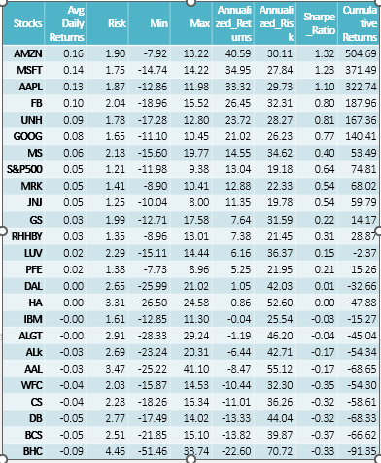
KEY METRICS
At the end of 5 years we can see that top 7 stocks having returns greater than S&P500
AMZN gives 40.59% annual returns
MSFT gives 34.95% annual returns
AAPL gives 33.32% annual returns
FB gives 26.45% annual returns
UNH gives 23.72% annual returns
GOOG gives 21.02% annual returns
MS gives 14.55% annual returns
S&P500 gives 13.04% annual returns
Stocks like Amazon (AMZN), Microsoft (MSFT), and Apple (AAPL) have relatively high annualized returns, low volatility, and positive Sharpe Ratios, indicating strong risk-adjusted performance.
Stocks like Wells Fargo (WFC), Credit Suisse (CS), and Deutsche Bank (DB) have negative cumulative returns, indicating a loss over the specified period. These stocks also have negative Sharpe Ratios, suggesting poor risk-adjusted performance.
Bausch Health companies INC(BHC) and American Airlines (AAL) have the most substantial negative cumulative returns, indicating significant losses

Slide 13
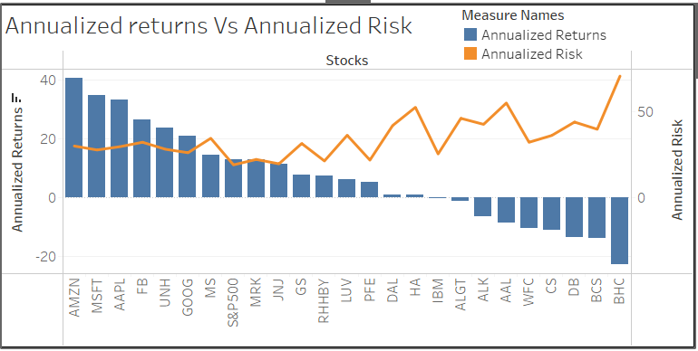
ANNUALIZED RETURN & ANNUALIZED RISK
AMZN, MSFT, AAPL, FB, and UNH exhibit robust annualized returns, all surpassing the 20% mark.
These top five stocks are associated with a moderate level of risk when compared to their counterparts in the market
Stocks with lower annualized returns, such as BHC, BCS, DB, CS, and WFC, pose a higher risk as they fail to generate returns on the initial investment
Conversely, JNJ, MRK are identified as stocks offering comparatively lower risk while still providing stable returns.

Slide 14
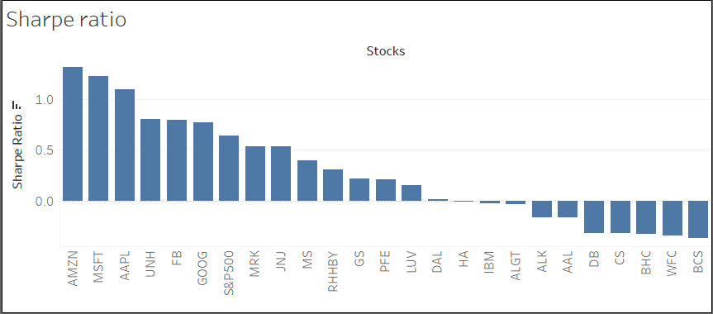
SHARPE RATIO
A higher Sharpe ratio indicates a better risk-adjusted performance while negative Sharpe ratios suggest that the returns may not be justifying the level of risk associated with those investments.
AMZN (1.32), MSFT (1.23), AAPL (1.10), FB (0.80), and UNH (0.81) have positive Sharpe ratios, indicating that these stocks have provided returns that exceed the risk-free rate per unit of risk.
S&P500 (0.64) is used as a benchmark. Stocks with Sharpe ratios close to the S&P500 may be considered to have a risk-adjusted performance in line with the broader market.
IBM,ALGT,ALK,AAL,WFC,CS,DB,CS and BHC have negative Sharpe ratios, indicating that the returns are not compensating enough for the associated risks.

Slide 15

PORTFOLIO ANALYSIS

Slide 16
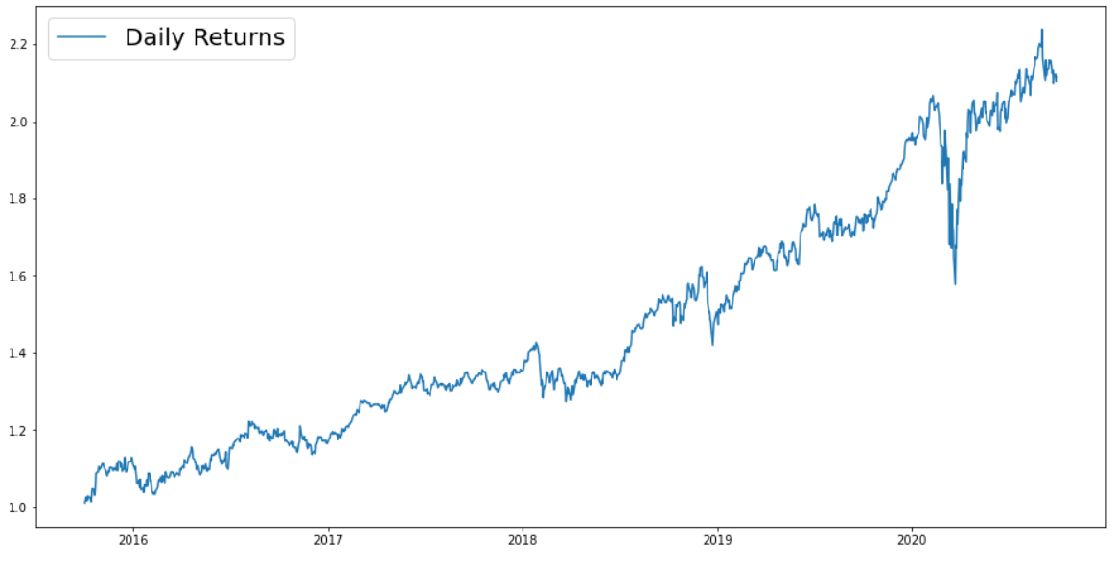
PATRICK JYENGER PORTFOLIO
Mr. Patrick Jyengar wants to double his investment in the span on 5 years. He wants to invest in low-risk stocks which would fetch him decent returns.
As per his profile Low risk stocks like JNJ,RHHBY and MRK is suitable to invest on. But overall returns with these three stocks wouldn't reach the target what Mr. Patrick is investing for. A portion of his wealth can be invested on MSFT to gain the desired returns.
Keeping all the weightage of stocks equal that is 0.25 across all stocks.
As Mr. Patrick Jyengar invests 500 Thousand Dollar in equities i.e., the above Portfolio. Returns that he would fetch after 5 years is 1.05 Million Dollar with 558.23 Thousand dollar of gain on investment.

Slide 17
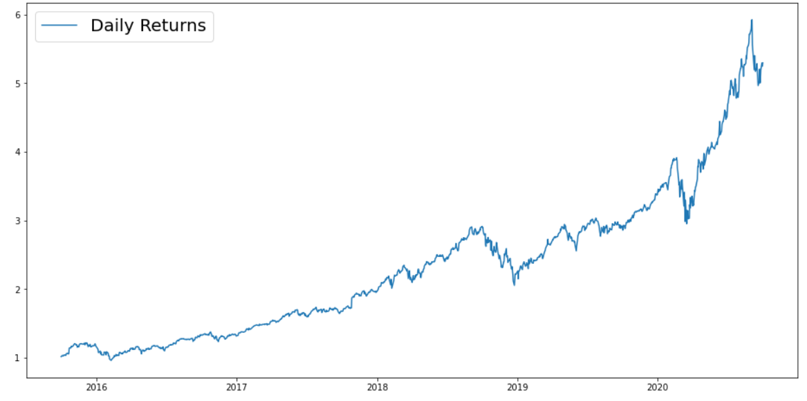
PETER JYENGER PORTFOLIO
Mr. Peter Jyengar on the other hand Consistent with his attitude towards risk, he prefers high-return investments. Believes that he can still bounce back in case of any occasional losses.
He Wants to invest $1 million from company's cash and cash equivalents in the most high-margin stacks Expects high returns within 5 years for inorganic expansion of his company.
As per his profile stocks like AMZN, MSFT and AAPL is suitable to invest on.
Overall returns with this stock would fetch him Maximum returns and cater the Risk.
As Mr. Peter Jyengar invests 1 Million Dollars in equities. The returns that he would get after 5 years of time period is more than 5 Million Dollars with more than 4 Million Dollars of gain.

Slide 18

METHODOLOGY

Slide 19
EXPLORATORY DATA ANALYSIS:
Examined the dataset for null values and confirmed that no columns contained missing data.
Conducted an outlier analysis on the dataset to identify and evaluate any data points significantly deviating from the overall pattern.
Imputed missing values with "0" for Facebook (FB) data, taking into account its listing on the NYSE on May 18, 2012
DATA ANALYSIS:
Applied diverse calculations, including daily and cumulative returns, Sharpe ratios, portfolio risk, and ROI, for in-depth stock data analysis
Identified top-performing stocks for various portfolios based on rigorous performance metrics.
Used Tableau for better visualizations.
Performed sector wise analysis to get a better view of each sector.
Extracted valuable insights to support informed decision-making in stock selection and portfolio management
INFERENCES AFTER ANALYSING THE DATA:
As we found out that there are 7 stocks which gives more than 80% in last five years of stock market.
The stocks that gives best return among all stocks are AMZN, MSFT, AAPL, FB, UNH, GOOG and MS.
Conducted a detailed analysis of each stock, considering factors such as Annualized risk, Sharpe ratio, and cumulative returns.
We found out that AMZN gives highest return among all stock .
We also found that stocks like JNJ, RHHBY, MRK and MSFT have good returns with less risk.
By observing the sectors we understand that the best performing sector is Technology followed by Health and Pharma and the worst is Aviation.
So after doing all the analysis we have finalized the portfolio for both of our customers.

Slide 20
THANK YOU

